Slide 1
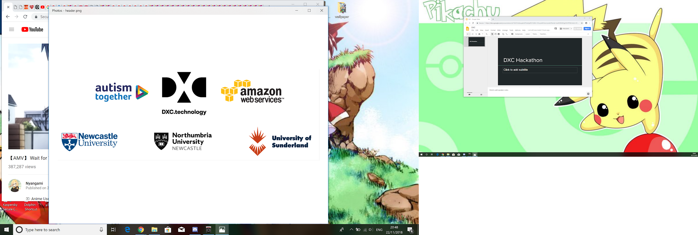
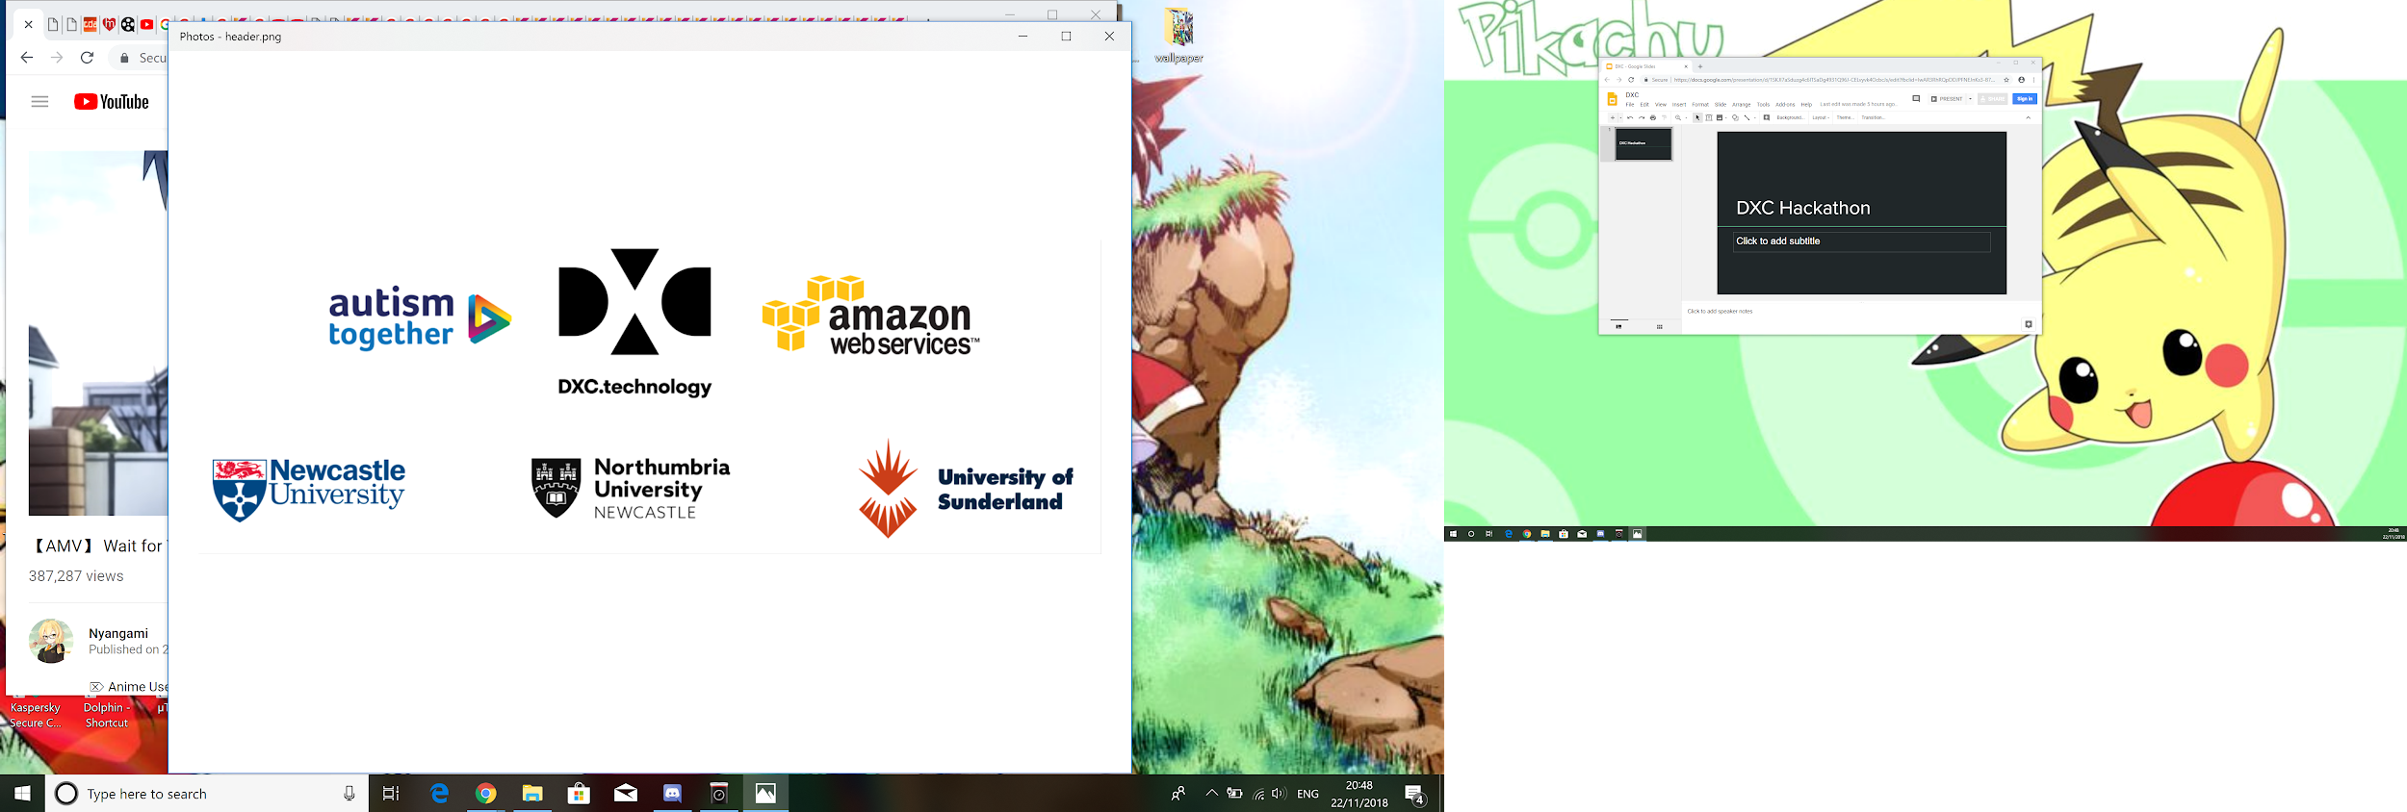
DXC Hackathon
Team 8
Notes:
Speaker: Kat
Introduction -> can introduce group

Slide 2
Problem Statement
The problem: How do we prevent or detect autism meltdowns?
Autism Together description
Solution?
Increase in heart rate = increase in anxiety -> meltdown
Detect when heart rate is rising above average
Notify if that's the case and offer solution by looking at the environment
Suitability of MVP
Notes:
Speaker: Kat
Brief overview -> talk about what the problem statement is, what we were required to do for it (eg needed to use aws services to create analysis of data from sensors from autistic people to detect when their next meltdown is )
Our approach -> mention technologies we’ve used (the data stream, kinesis, lambda, alexa skills?)<< mentioned in research part
MVP (minimum viable product) Suitability -> is this problem statement good to create one working function and then deploy it in a small environment, to see if the current functionality is satisfactory enough?

Slide 3
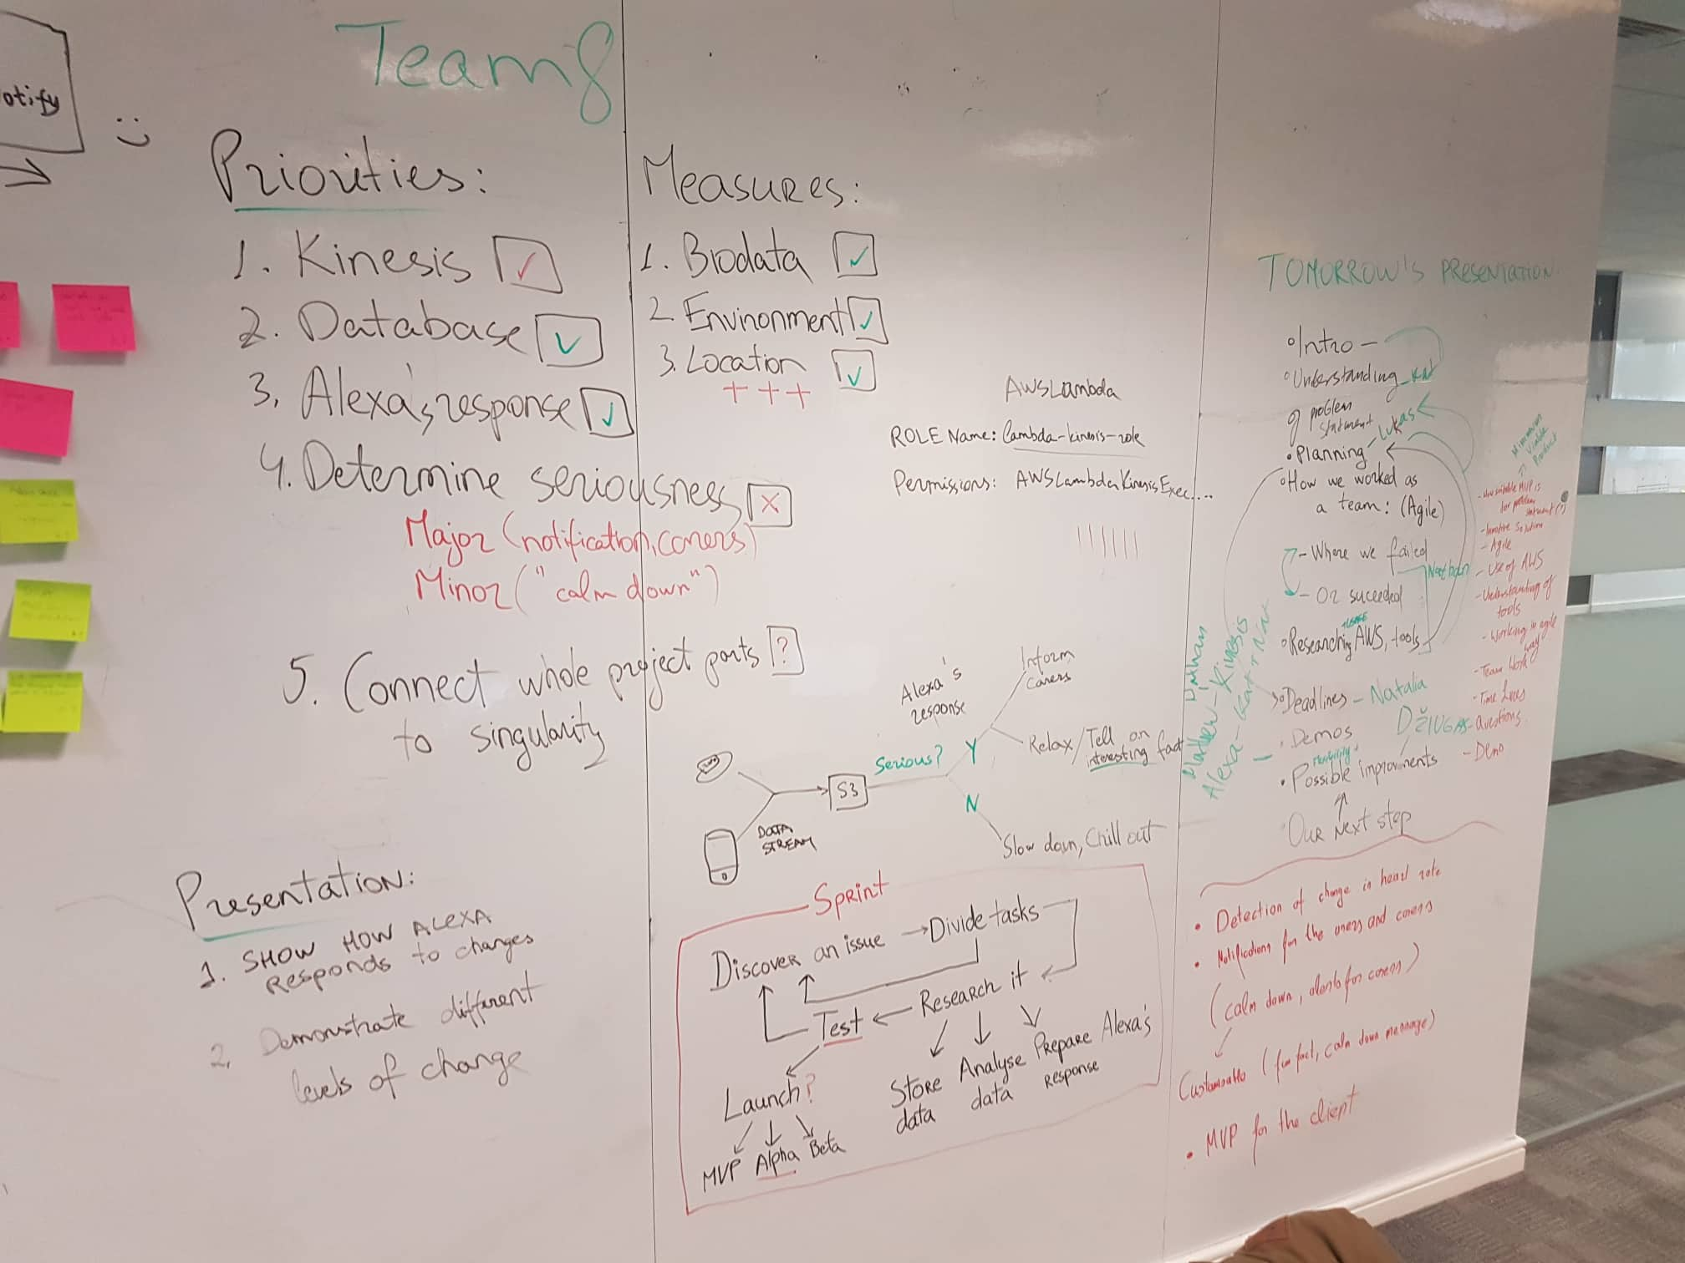
Work as an Agile team
Brainstormed issues and solutions
Careful planning
Division into sub-teams
Different sprint leaders
Notes:
Speaker: Lukas

Slide 4
Deadlines
Agile-styled Sprints
Reallocation of tasks
Allocate tasks
Meet deadline
Discuss progress
Reallocate task
Notes:
Speaker: Natalia
Sprints -> during the project, consistently assigned small tasks for ourselves for a short deadline, after which we’d discuss the progress of each team member and then would allocate new tasks. These short deadlines enabled us to get major parts of our solution to be sufficiently completed
Reallocating -> sometimes needed to assign more members on a particular task when we came across a problem

Slide 5




Researching
AWS services and tools
Tutorials
Notes:
Speaker: Nathan
1 (AWS services and tools) - Used Kinesis, DynamoDB, Athena, S3.
2 (tutorials) - we followed many tutorials (sometimes made things more confusing, but sometimes helped!)

Slide 6
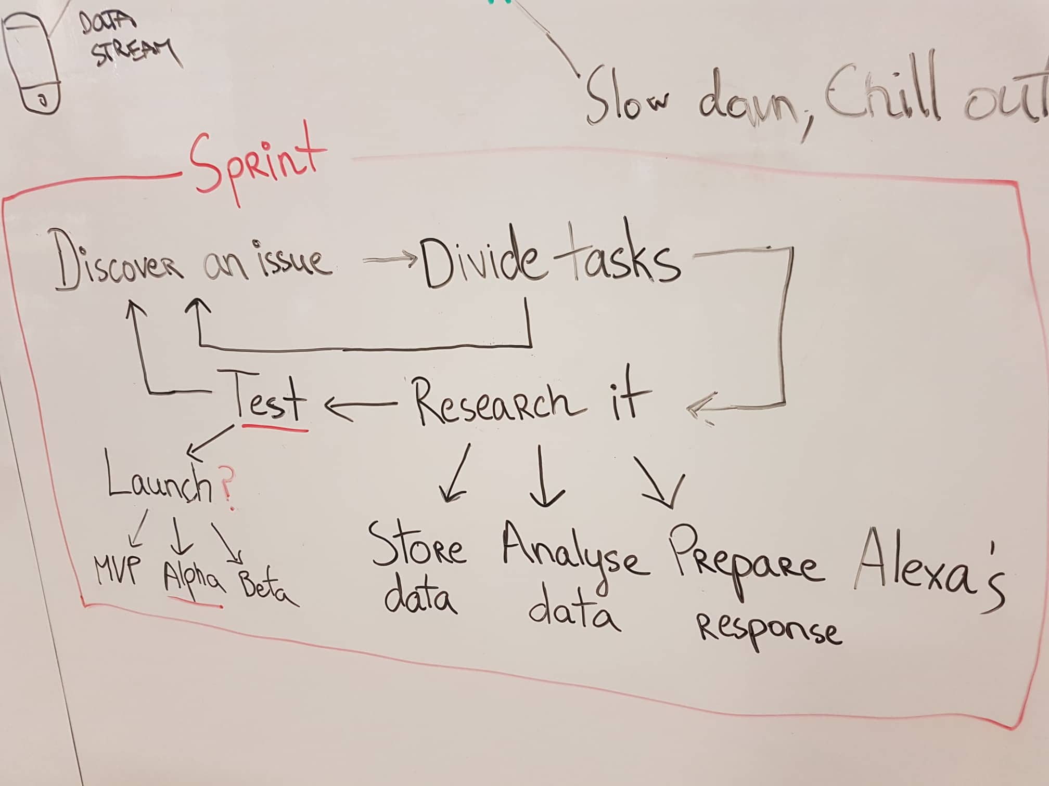
Overview of what we have done
Making a real-time data generator
Aggregate the data
Store the aggregated data into a back-end database
Archive the raw data generated to another database
Notes:
Speaker: Lukas?

Slide 7
Problems we encountered
We were given a flat (csv) data whereas the specification requires real-time data
Solution: creating our own data generator (producer) in Go language
Alexa cannot be triggered without user’s invocation (eg: Alexa open… / Alexa tell … to …)
Solution: currently being developed by Alexa
Notes:
Speaker: Nathan
In this part we need to emphasize that initially we tried to use the flat data and ended up wasting time
2) The feature is currently being developed by alexa and is due to be released

Slide 8
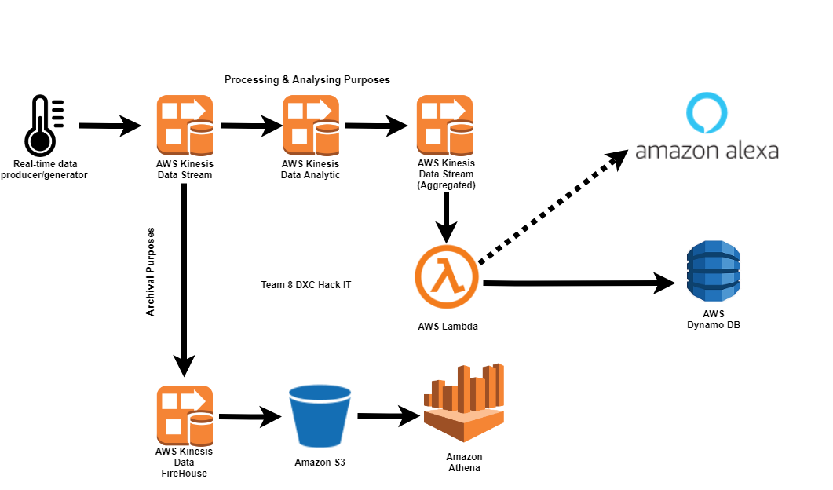
Application Architecture
Notes:
Speaker: Nathan?
Processing and Analysing purposes:
1 (Real-Time data producer/generator) - Making data producer and consumer to generate real-time data instead of using flat csv data (Michael’s awesome Go coding)
2 (AWS Kinesis Data Stream) - Putting those real-time generated data into a data stream
3 (AWS Kinesis Data Analytic) - Using Kinesis data analytic to analyse and aggregate the data (Min, max, average)
4 (AWS Kinesis Data Stream (Aggregated) ) - Store the aggregated data into another data stream
5 (AWS Lambda) - Using lambda function to store data from the application to a backend database…
6 (Amazon Alexa) - Possible improvement to sync with alexa
7 (AWS Dynamo DB) - ...stored in DynamoDB. Queries are ran against the data. DynamoDB has great scalability.
Branch for archive:
1 (AWS Kinesis Data Firehouse) + (Amazon S3) - Flush the raw data stream to S3 bucket by using kinesis firehose
2. (Amazon Athena) - Using Athena, run SQL queries against the raw data for ad-hoc analyses.

Slide 9
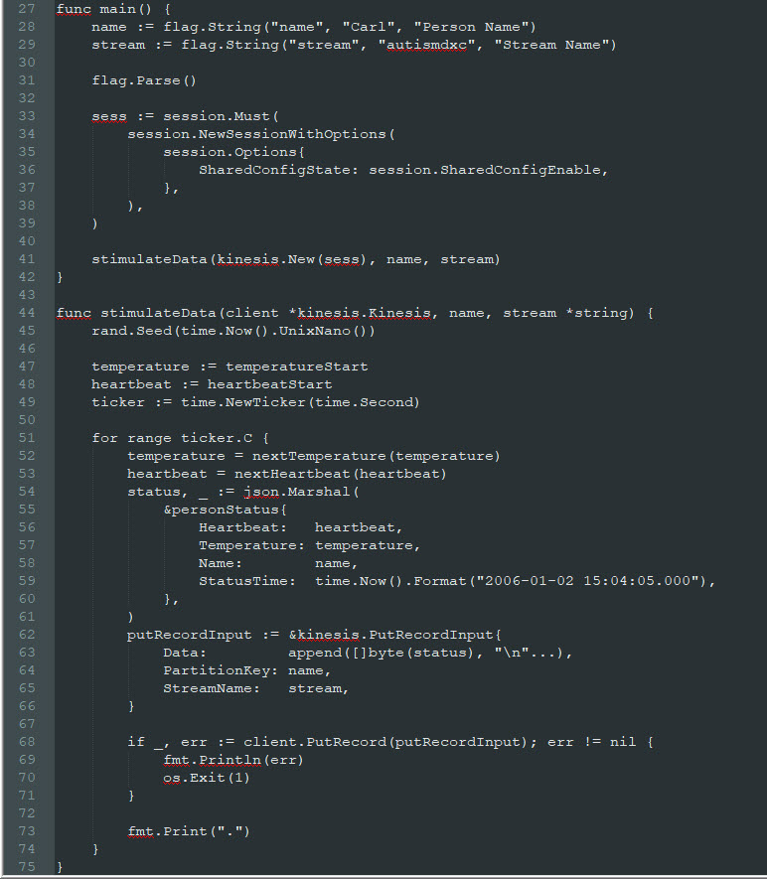
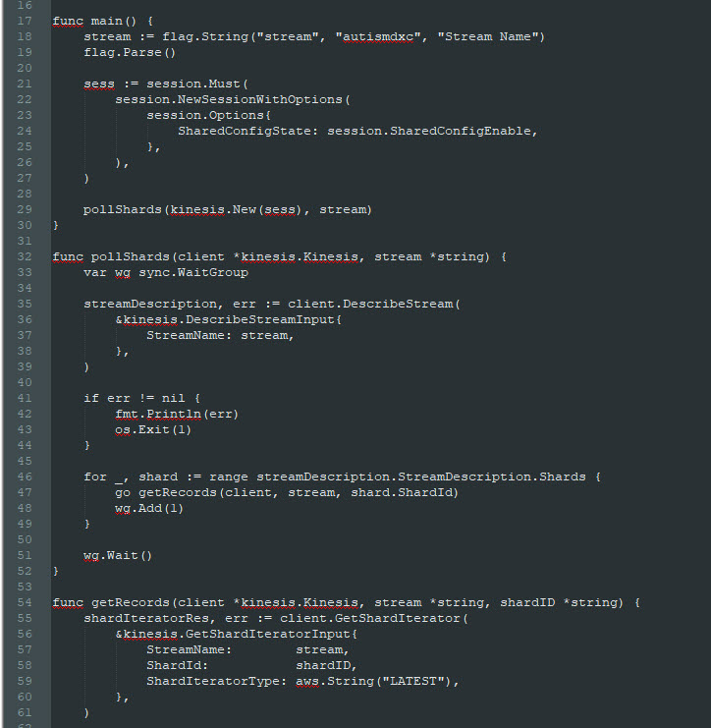
Demos
Notes:
Speakers: Nathan, Michael for Kinesis
Kat, Natalia for Alexa
Data -> Showcase data stream and kinesis working (real-life data being used to calculate minimum, maximum and averages (perhaps explain the technologies used to achieve this)
Alexa -> Showcase Alexa skill, where will ask what will happen if temperature rises too high, and Alexa replies

Slide 10
Possible improvements and our next step
Different approach to the problem
Flexibility of the solution
New features can be implemented
Notes:
Speaker: Dziugas?

Slide 11
Thank you
Questions?
Notes:
Speaker:??

